Slide 1


School of Computer Science & IT Department of BCA
INTRODUCTION TO LINUX(20BCA1C06)
MODULE 2: The UNIX File System
Faculty : Dr. Ananta Ojha

Slide 2
Session-5
System Calls for the File System
Open

Slide 3
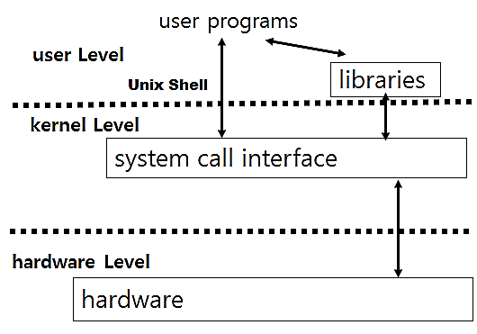
System Calls
A system call is just a request for the operating system to do something on behalf of the user's program.
The system calls are functions used in the kernel itself. They act as interfaces between user programs and Unix Kernel. (To the programmer, the system call appears as a normal C function call.)
UNIX system calls are used to manage the file system, control processes, and to provide interprocess communication.
These system calls use low level algorithms and data structures discusses earlier.
There are over100 system calls in UNIX and the number vary among different versions.
Examples:
Accessing existing files: open, read, write, lseek, close,
Create new files: creat, mknod,
Manipulate inode or file system:
chdir, chroot, chown, chmod, stat, fstat.

Slide 4
Open
Open is the first step to access data in a file.
fd = open (pathname, flags, mode);
Where
flags indicate the type of open
Reading only, O_RDONLY
Writing only, O_WRONLY
Both reading and writing, O_RDWR
Write-append, O_WRAP
mode gives the permissions if the file is being created.
It returns an integer fd called the user file descriptor. Other file operations (e.g. read, write etc.) use the file descriptor returned by open.

Slide 5
Major Steps
The kernel searches the file system for the file pathname and converts it to inode using algorithm namei
After getting the in-core inode of the file to be opened, the kernel allocates an entry in the file table and sets the offset of the file.
The offset tells the kernel from where to read or write to the file. In the case of read and write, the offset is set to 0, but for write-append , the offset is set to the size of the file.
Then the kernel allocates an entry in the user file descriptor table. The user file descriptor table entry has a pointer to its file table entry and the file table entry has a pointer to the in-core inode table entry.
If the file already existed, and open for writing, the kernel truncates the file (releases all existing data blocks and sets the file size to 0) subject to suitable file access permissions.
Returns the file descriptor . The file descriptor returned to the user is nothing but the index of the entry in the user file descriptor table.

Slide 6
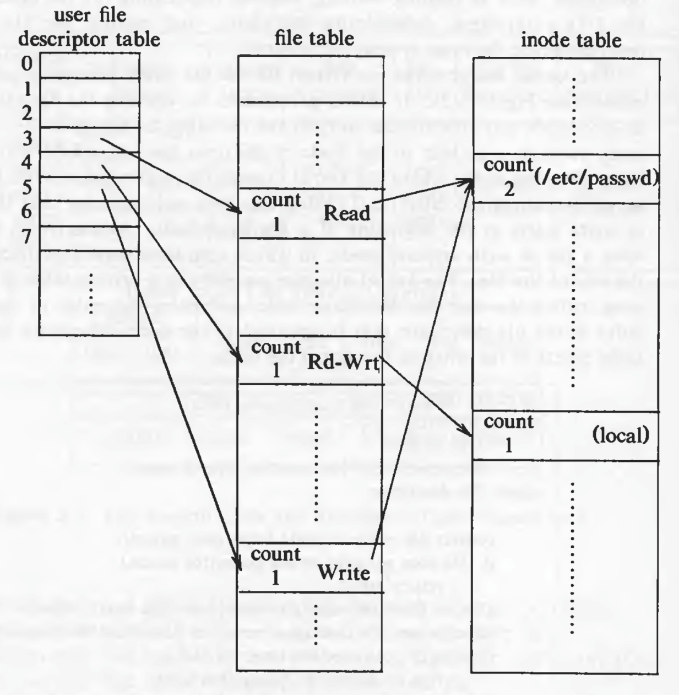
Example
If a process executes following code:
fd1 = open ("/etc/passwd", O_RDONLY);
fd2 = open ("local", O_RDWR);
fd3 = open ("/etc/passwd", O_WRONLY);
In this case, the state of the in-core inode table, file table, and user file descriptor table will be like this:

Slide 7
Algorithm: open
/* Algorithm: open
* Input: pathname, flags, mode
* Output: file descriptor
*/
{
convert file path name to inode (Algorithm: namei);
if (file does not exist or access is not permitted)
return (error);
allocate file table entry for inode, initialize count, offset;
allocate user file descriptor entry, set pointer to file table entry;
if (type of open specifies truncate file)
free all blocks (algorithm: free);
unlock (inode); /* locked above in namei */
return (user file descriptor);
}

Slide 8

THANK YOU Any questions…?

